Slide 1
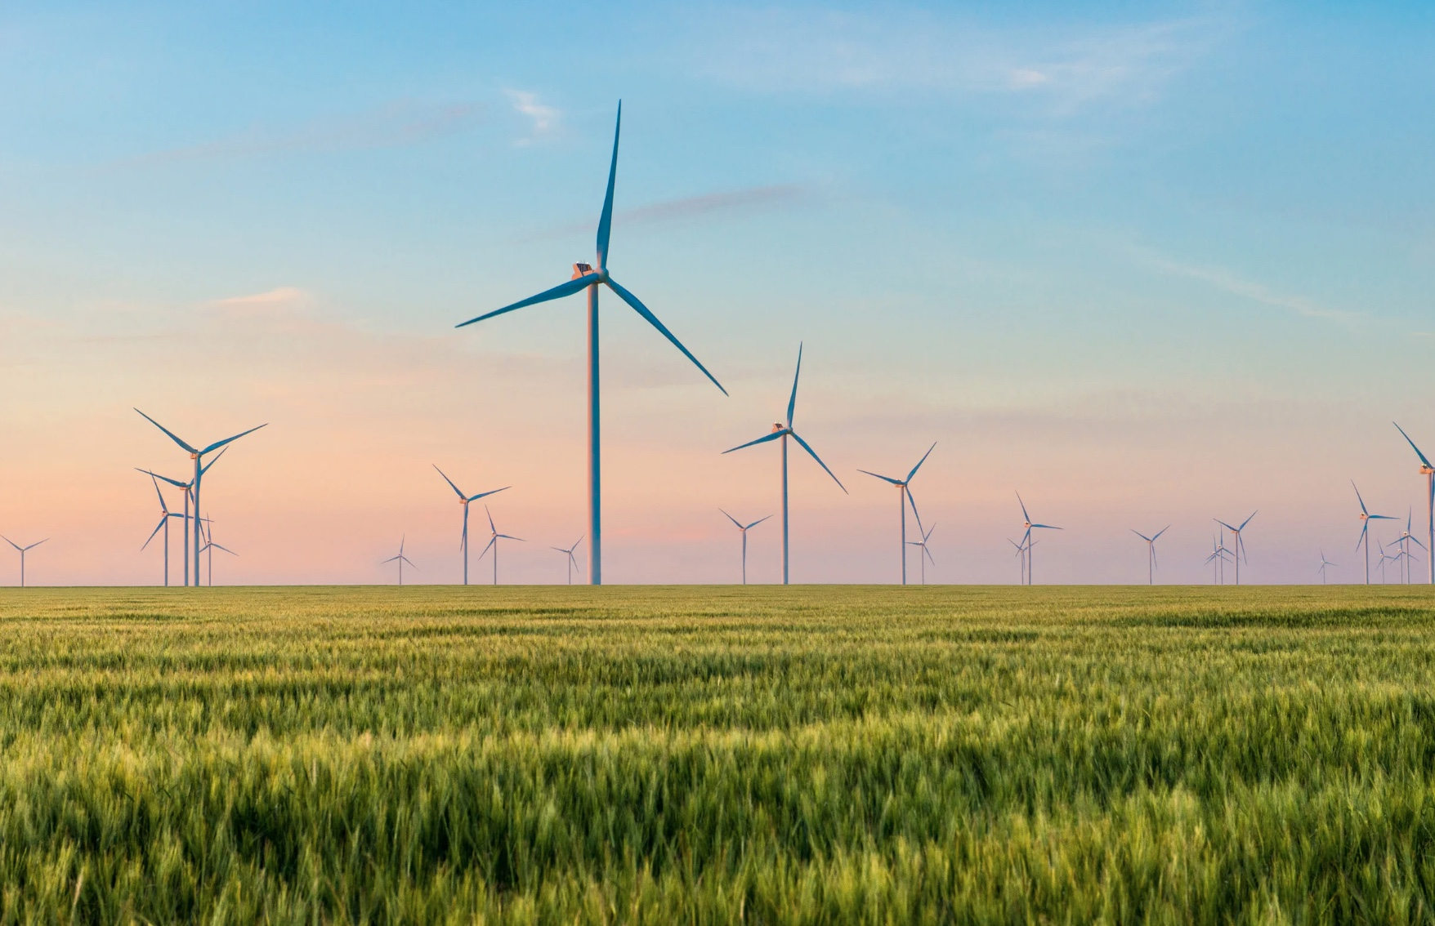
A Short Course on Macro-Fiscal Climate Economics
Module B: Fiscal Risks

Slide 2
Table of Contents
Course Outcomes
Climate and GDP
Climate Fiscal Risks
Climate Change Fiscal Institutions

Slide 3
Three Key Outcomes
Introduction to Climate Economics: Explore climate economics through a fiscal lens, focusing on national and international efforts to achieve Paris Agreement targets.
Comprehensive Approach to Green Transition: Analyze the fiscal, financial, and energy security aspects of transitioning to a green economy, with a focus on perspectives relevant to middle-income countries like Ukraine.
Preparation for Professional Opportunities: Prepare participants for potential roles in the World Bank by developing skills for Short Term Consultancy (STC) opportunities.

Slide 4
UK Fiscal Risks and Sustainability Report (2023)
Dunz and Power (2021), ‘Climate-Related Risks for Ministries of Finance’
Swiss Re (2009), Economics of Adaptation Report

Slide 5
“Climate transition risk… could emerge from sudden and uncoordinated climate policies, technology disruptions, and altered consumption preferences during the transition towards a carbon-neutral economy. This could drive entire sectors out of business and lead to abrupt financial asset revaluation and stranded high-carbon assets with negative implications for the real economy and government budgets. Both, climate physical and climate transition risk, could amplify macroeconomic risks, with finance being a potential driver of risk amplification.”
(Dunz and Power, 2021)

Slide 6
Climate (Physical) Risks

Slide 7
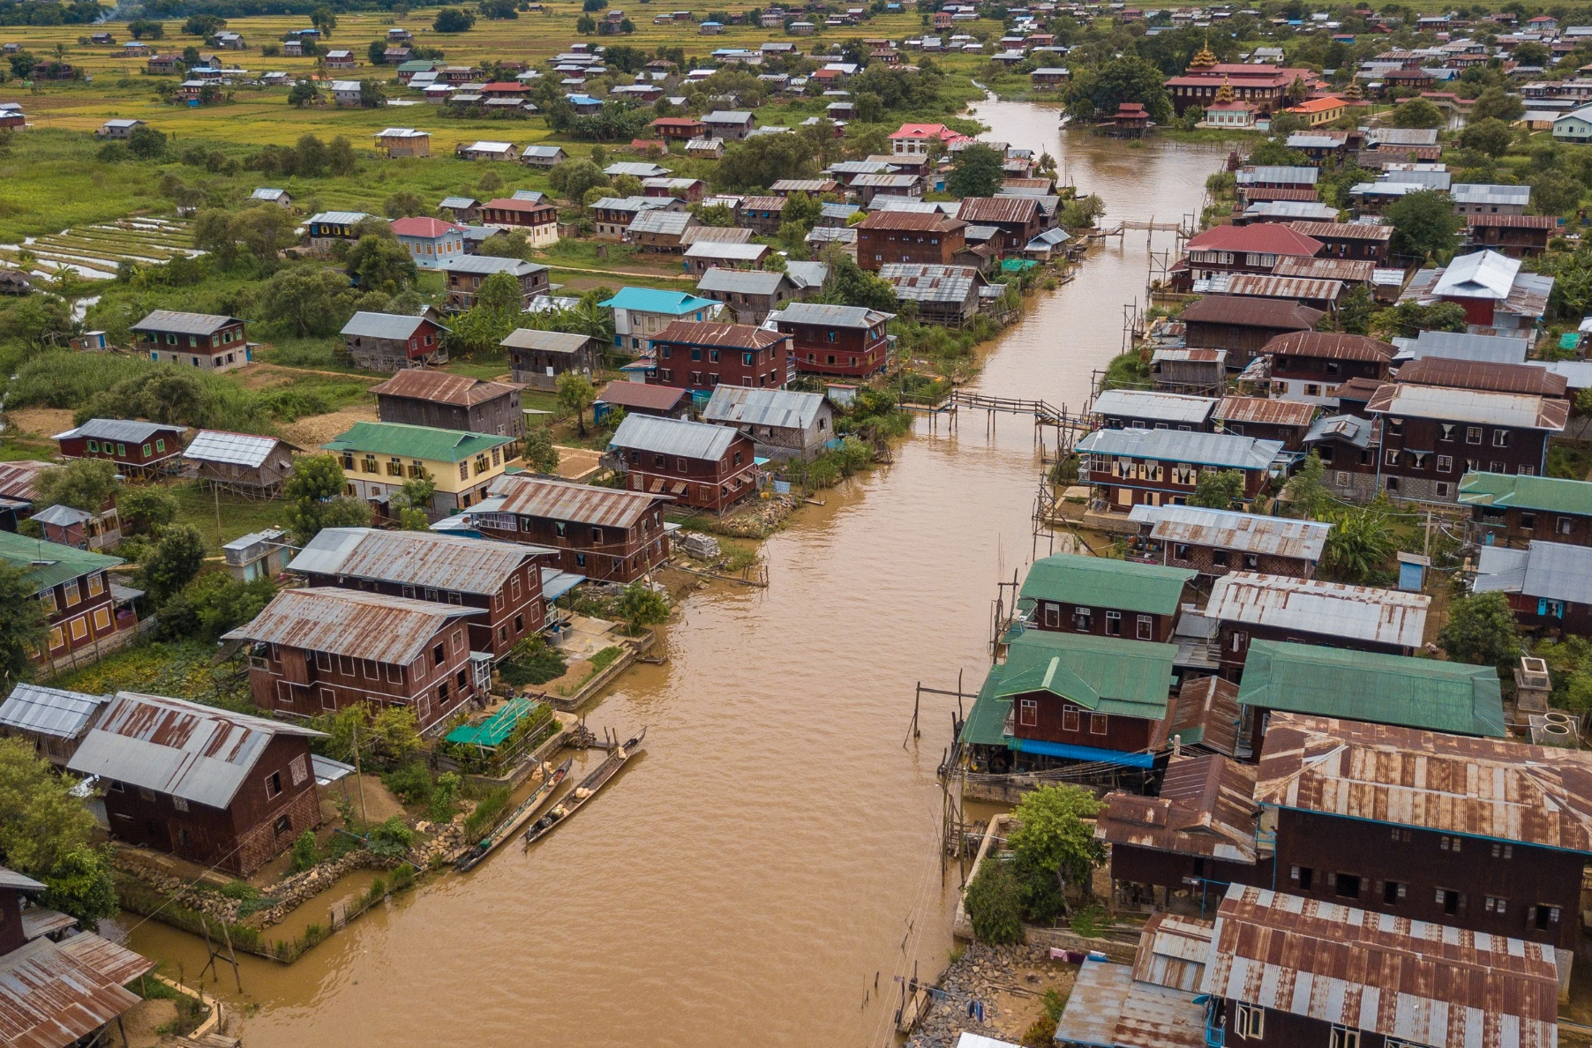
Physical Risk
“…the potential effects on people, communities, natural and physical capital, and economic activity, and the implications for companies, governments, financial institutions, and individuals.” (Woetzel et al., 2020).
Physical risks can be:​
  Chronic- longer term impacts from gradual climate change (e.g. rise in average temperatures/sea levels/ocean acidification, changes in precipitation, etc.). ​
  Acute- short term impacts from extreme climate-related weather events (e.g. storms, fires, floods, heat waves, etc.).
From: Jackson (2024).

Slide 8
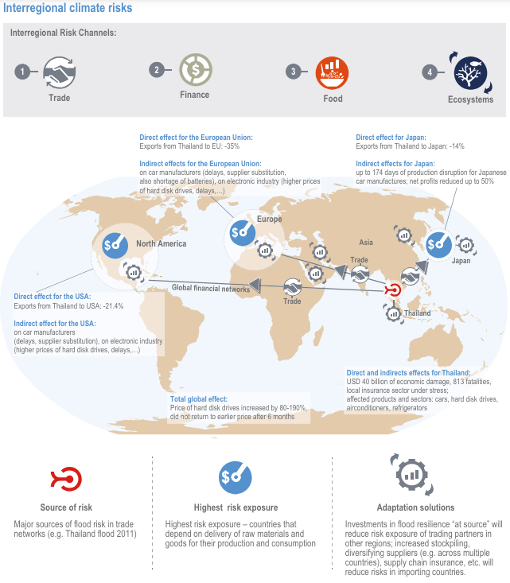
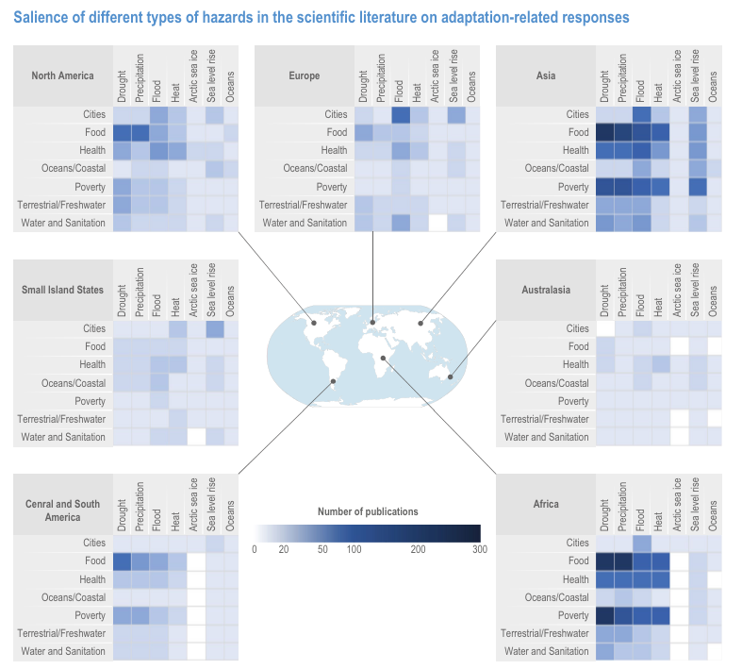
IPCC AR6 Risks

Slide 9
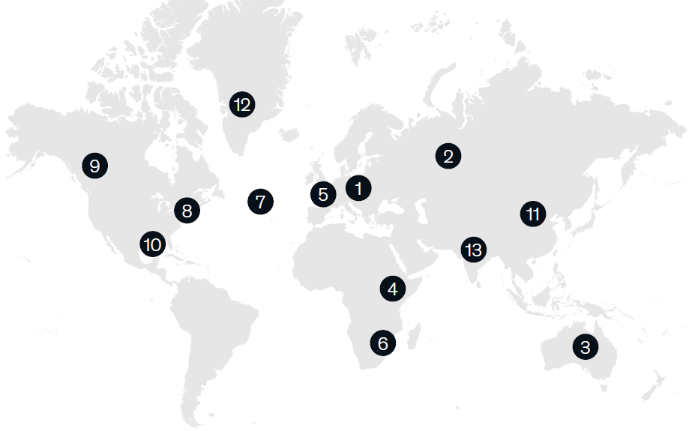
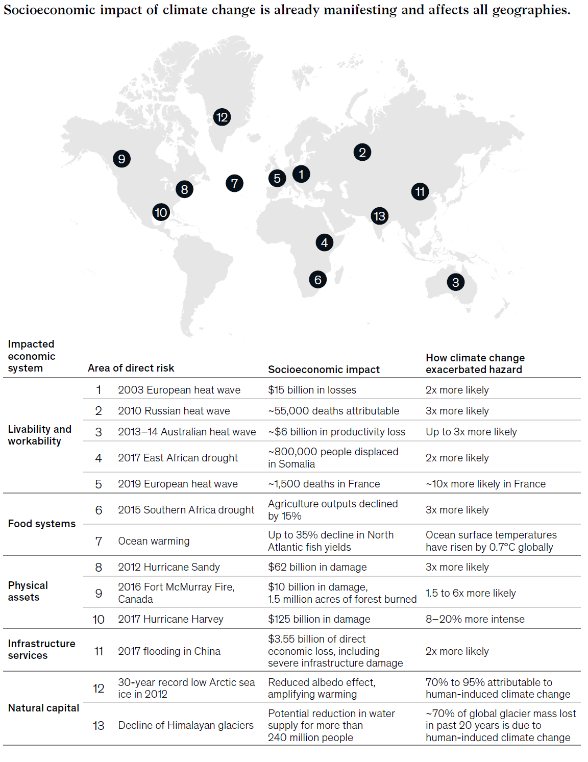
Examples of Physical Risks: Living and Working
From: Jackson (2024). Original Source: Woetzel et al. (2020).

Slide 10
Examples of Physical Risks: Infrastructure and Natural Capital
From: Jackson (2024). Original Source: Woetzel et al (2020).

Slide 11
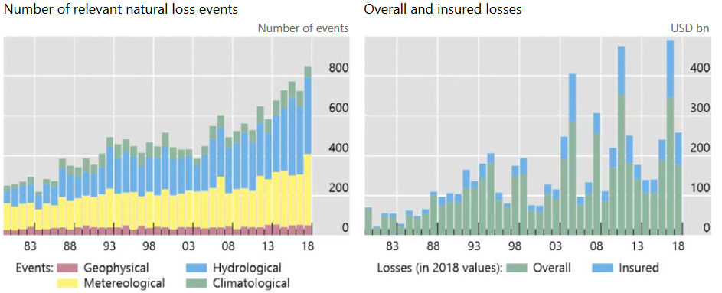
Physical Risks: Weather-Related Losses Worldwide (1980-2018)
From: Jackson (2024). Original Source: Bolton et al. (2020).

Slide 12
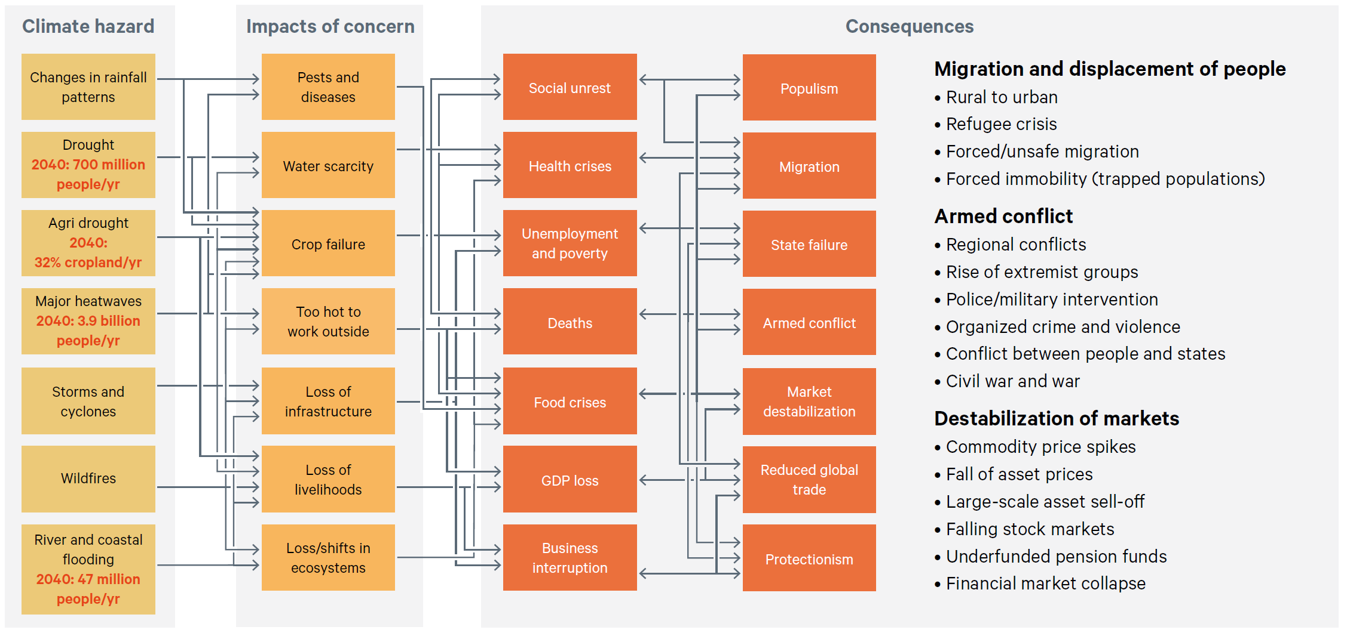
Summary of the Major Systemic Risk Dynamics
From: Jackson (2024). Original Source: Quiggin et al. (2021).

Slide 13
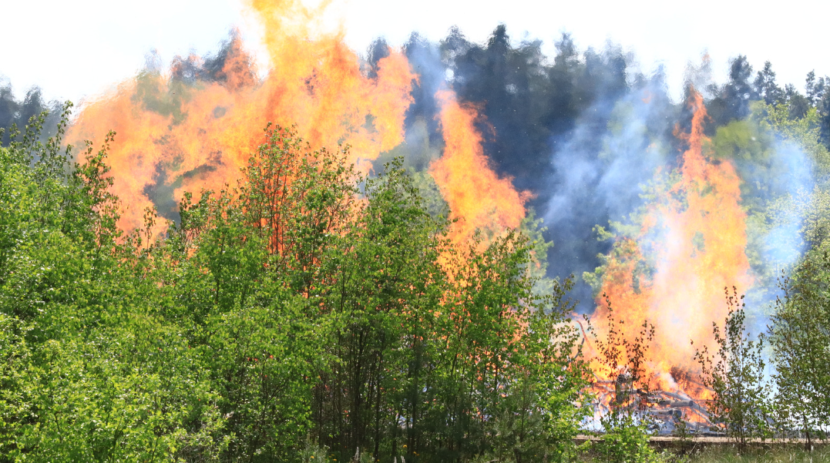
Example: Ukraine
Economic structure, anthropogenic impacts, and geographical features make Ukraine highly susceptible to climate impacts.​
Disaster Impact Growth:​
2020 Losses: Over 6 times higher than 2019, increasing from UAH 1.6 billion to UAH 9.9 billion. Mainly due to droughts (south), wildfires (north & east) and flash floods (west).​
Fighting-Induced Wildfire Expansion: Forest fires burned 25 times more area in 2022 than in 2021.​
Future Risks:​
Rising Temperatures & Shifting Seasons: More frequent floods, shifting precipitation, and rising sea levels along the Black Sea coast.​
Water Security Threat: Ukraine is one of the least water self-sufficient countries in Europe. Decreasing river flows will worsen water pollution and degrade water quality.​
Agricultural Impact: Wheat yields will decrease, threatening one of Ukraine’s key exports. Scorched agricultural lands and dry wetlands lead to more frequent fires and deteriorating air quality.

Slide 14
GDP Risks

Slide 15
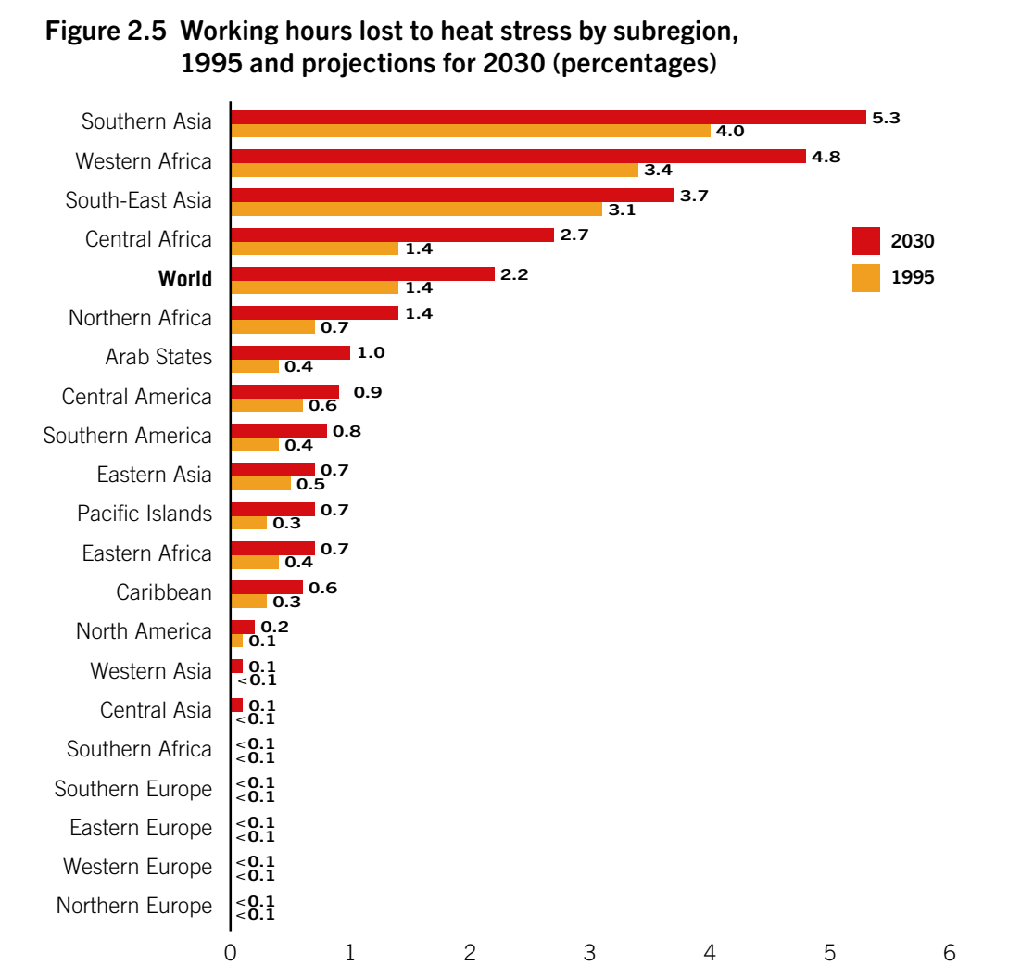
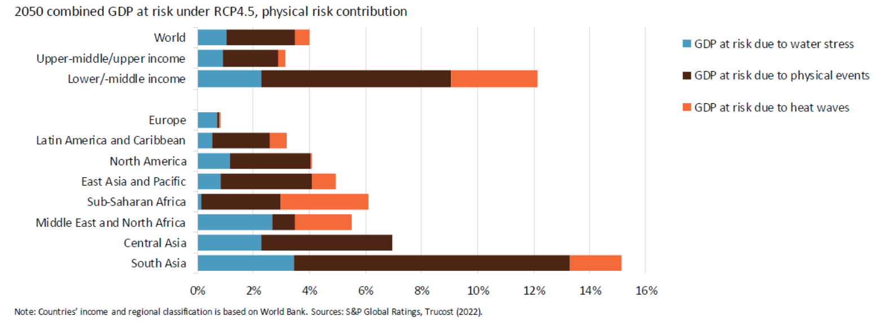
Short-Term GDP Risk
Extreme Weather Events: Increased frequency and severity of natural disasters (e.g., hurricanes, floods, wildfires) cause direct damage to infrastructure, agriculture, and housing. Leads to significant economic losses, particularly in vulnerable regions.
Agricultural Productivity: Shifts in climate patterns disrupt crop yields, leading to food insecurity and higher prices. Economic output in agriculture-dependent regions is particularly affected, reducing GDP.
Working Hours Lost Due to Heat Stress 1995 vs 2030 (%)
2050 Combined GDP at Risk under RCP4.5 from Physical Risks
Source: International Labour Office (2019).
Source: Jones (2022).

Slide 16
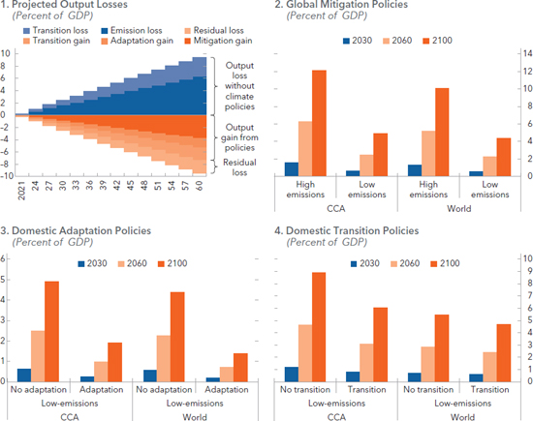
Long-Term GDP Impacts
Projected Output Loss in Climate Scenarios (Per capita annual GDP losses in % of baseline)
Health Impacts:
  Increased prevalence of climate-related health issues (e.g., heatwaves, vector-borne diseases) reduces workforce productivity.
  Rising healthcare costs strain public finances.
Reduced Investment and Economic Growth:
  Uncertainty and risks associated with climate change may deter investment in vulnerable regions.
  Long-term economic growth may be hampered by the delayed onset of costs for adaptation and mitigation, and recovery from climate impacts.
Migration and Displacement:
  Climate change-induced migration leads to demographic shifts, disrupting labour markets and increasing social and economic pressures in receiving regions.
Source: Gigineishvili et al. (2023).

Slide 17
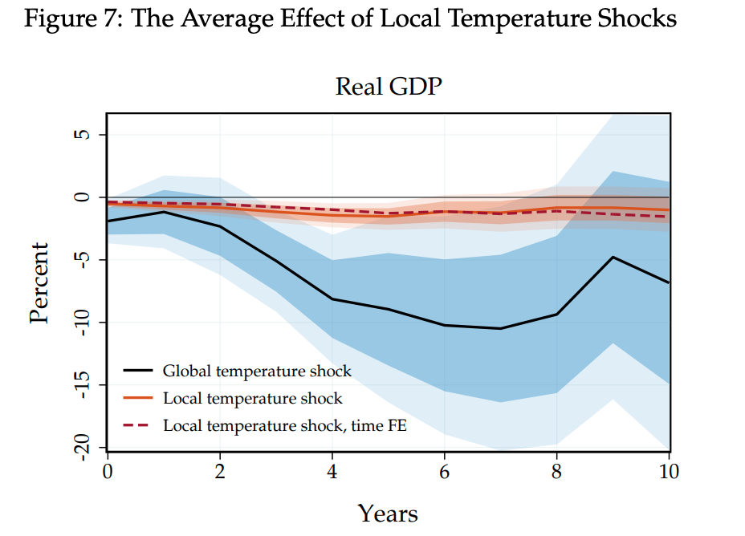
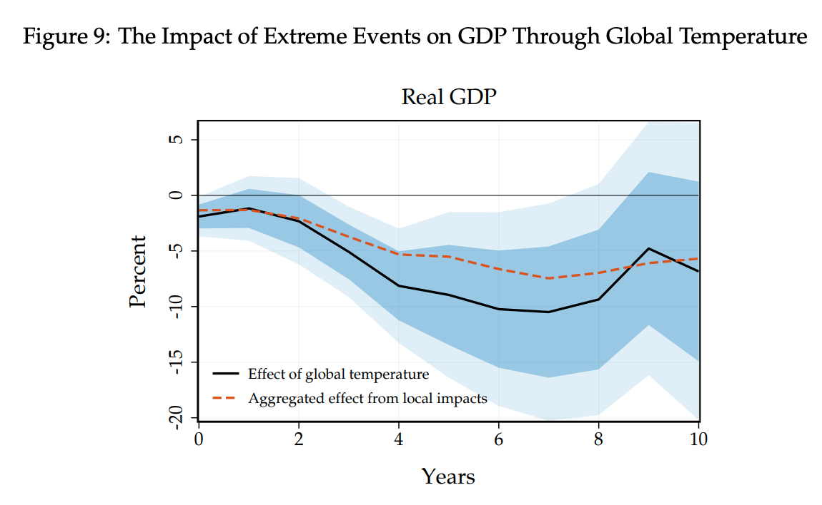
GDP Risk Uncertainty
Traditional Estimates Understated: Previous estimates suggested a 1°C rise in temperature reduces global GDP by only 1-3%, considered minor.
New Findings: Using advanced time-series analysis, updated research from Bilal and Känzing (2024) shows that a 1°C increase leads to a 12% reduction in global GDP at its peak.
Long-Term Impact: The economic decline persists for years, with significant welfare losses (29% in present value) and a much higher Social Cost of Carbon (SCC) estimated at $1,065 per ton.

Slide 18
Transition Risks

Slide 19

Transition Risk
“The financial risk which can result from the process of adjustment towards a lower-carbon economy.” (Bank of England, 2017).
Transition risks can occur due to changes in:​
  Policy and regulations.​
  Technology.​
  Social norms.​
Major transition risks: ​
  Stranded fossil fuel assets & financial transition risks.​
  Energy prices.​
  Fiscal risks.​
  Critical mineral shortages & supply chain concentration.
From: Jackson (2024).

Slide 20
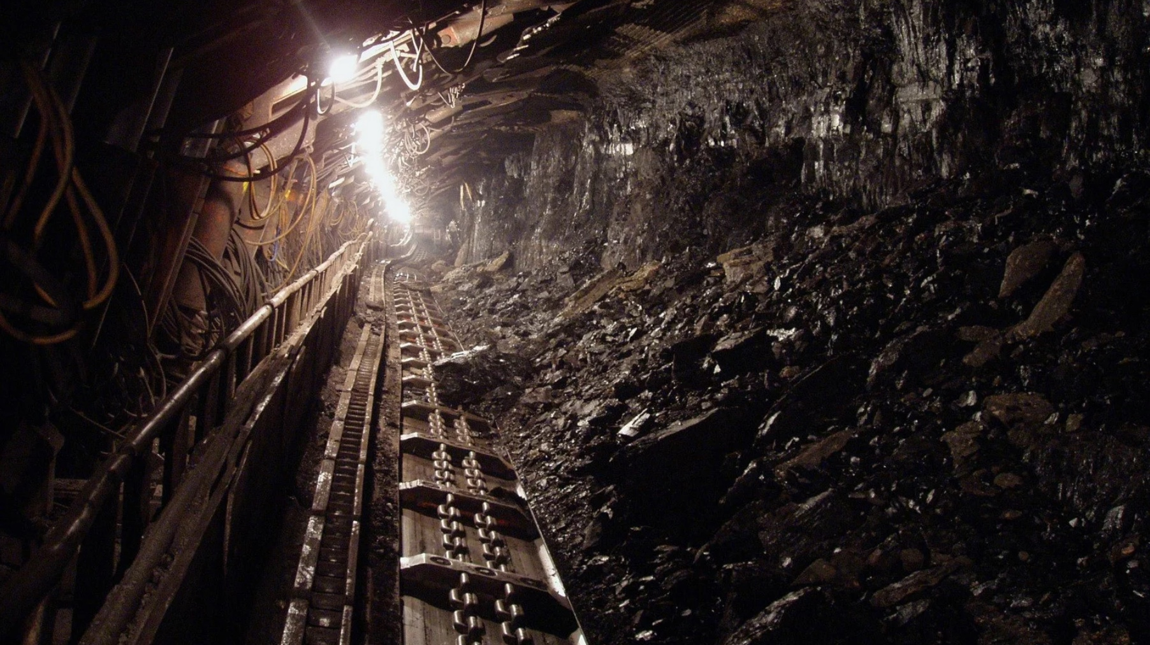
Stranded Assets & Financial Transition Risk
“Assets that have suffered from unanticipated or premature write-downs, devaluations or conversion to liabilities.” (Caldecott, 2013).
Stranded assets can be:
  Unburnable carbon: Oil, gas, and coal reserves and resources that will need to be ‘left in the ground’.
  Stranded capital: Capital assets that will need to be retired before the end of their economic lives (e.g. oil rigs, processing terminals, pipelines, tankers, power plants)
  Wasted capital investment: Capital expenditures that will no longer make a return (e.g. oil and gas exploration, R&D, etc.).
From: Jackson (2024).

Slide 21
Potential Economic Impacts of Stranded Assets and Financial Transition Risks
Energy transition (due to carbon tax, technology, or norms)
Change in demand for green and fossil fuel sector goods strands fossil fuel assets
Decrease in value of fossil fuel assets on financial markets.
Change in profits, employment, etc. in energy and related sectors
Increase in non-performing fossil fuel loans
Banks and financial firms that hold these assets face losses
Banks and financial firms respond by tightening lending conditions
Negative knock-on effects on rest of economy
Further losses, tightening of credit conditions etc.
Further negative impacts on broader economy
From: Jackson (2024).

Slide 22
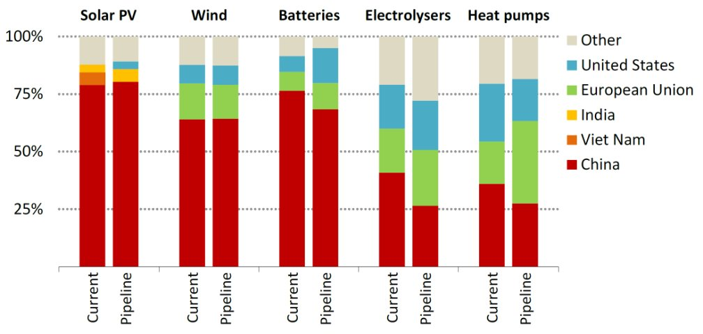
Key Technology Concentration
Key Technology Manufacture is also fairly concentrated, with China’s share of PV notable.
Source: IEA (2023)
From: Jackson (2024).

Slide 23
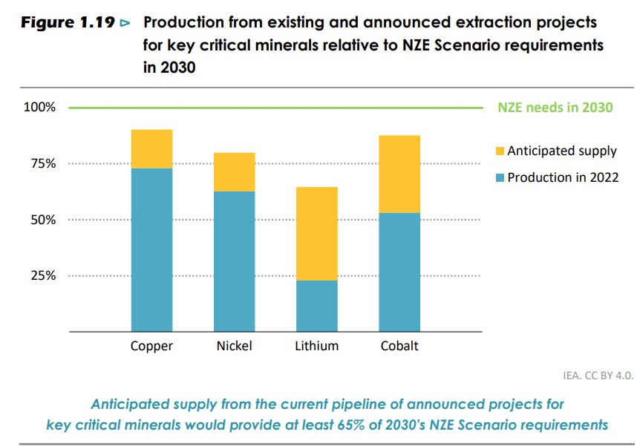
Critical Mineral Shortage and Supply Chain Concentration
Large quantities of critical minerals are required for clean energy technologies (e.g. wind turbines, EV batteries, CO2 pipelines, power grids, etc.). ​
Since clean energy technologies already account for high shares of total demand of these minerals (15-55%), the transition hinges on rapid expansions in secure mineral supply chains.
Three countries account for about:​
90% of global lithium mining output; ​
75% of global cobalt mining output ​
65% of global nickel mining output​
80 - 90% of global capacity in solar PV modules, wind turbine nacelles, EV batteries and electrolysis.
Risk to critical minerals can be minimized by increasing investment across geographies.
Source: IEA (2023)
From: Jackson (2024).

Slide 24
Energy Risks

Slide 25
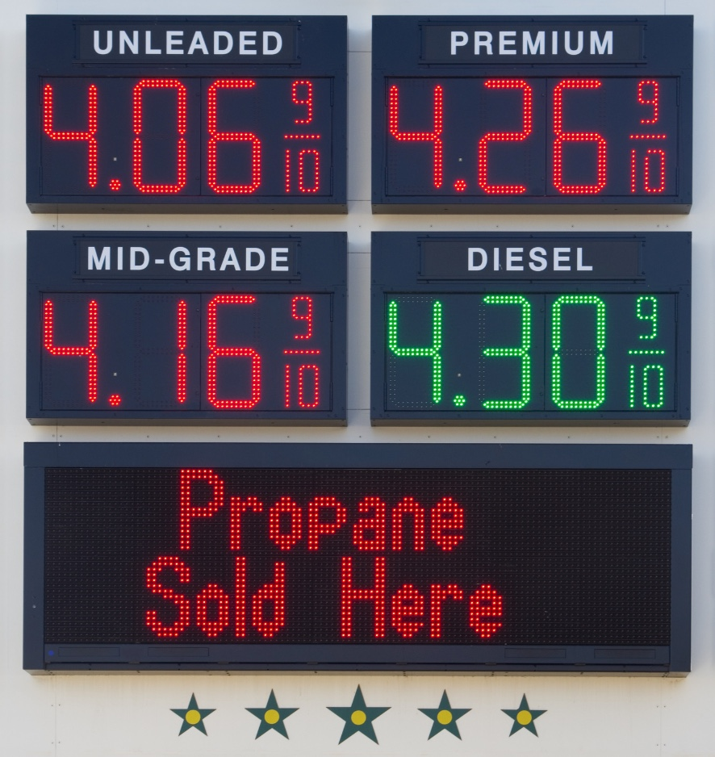
Energy Risks
Energy risks—such as price volatility, supply disruptions, or over-reliance on fossil fuels—can strain public finances. Countries often resort to costly energy subsidies, which increase fiscal stress, diverting resources from other priorities like healthcare, education, or infrastructure.
Fluctuations in energy prices can cause significant GDP contractions, particularly in energy-importing countries. Price spikes or supply shocks impact industries and households, leading to inflation, reduced economic growth, and job losses.
Reducing emissions through a shift to clean energy can lower these risks. Renewable energy sources like solar and wind have lower operational risks and are less vulnerable to global price fluctuations, contributing to greater energy security and fiscal stability over the long term.

Slide 26
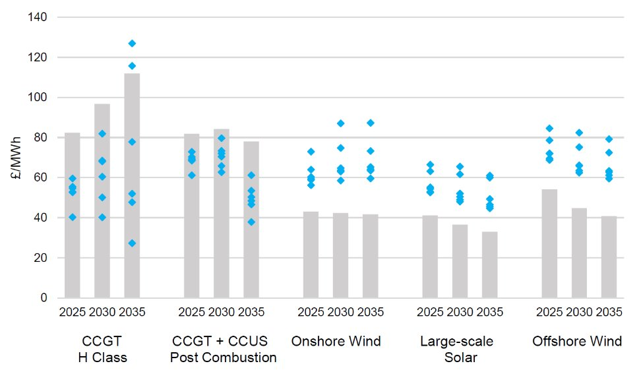
Increasing Energy Prices
Energy technology transition may lead to an increase in energy prices due to:​
  Huge investment required in a short space of time. ​
  Reduction in efficiency of overall energy sector, due to need to deal with renewable intermittency by adding energy storage or backup capacity.​
  Higher energy prices increase the prices of all goods and tend to be associated with negative economic outcomes.
Enhanced Levelized Energy Prices with Varying Low Carbon Capacity
Bars: original levelized cost.​ Dots: enhanced levelized cost (original levelized cost + technology’s wider system impact + other impacts [e.g. unpriced carbon & below maximum load factors]).
​ Source: Department for Business, Energy and Industrial Strategy. (2020). Electricity Generation Costs 2020. BEIS​
From: Jackson (2024).

Slide 27
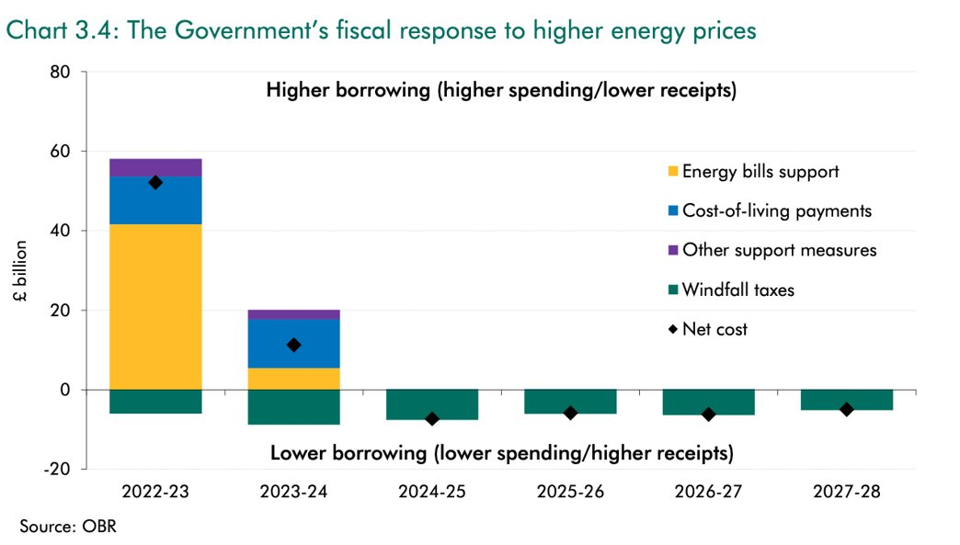
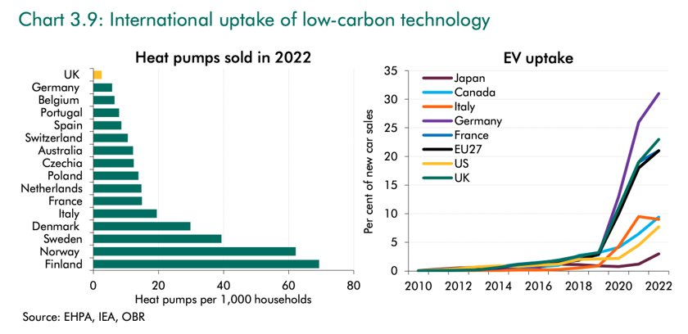
Case Study: UK Energy Transition
Gas now the most expensive fuel per megawatt hour in the UK.
UK expected to be 200% more exposed during price spikes by late 2030s.
Investment Impediments: Long, uncertain permitting system and grid connection wait times in the UK.​
To-date, the limited response from private energy investors to renewable energy price changes heightens risks to public finances.

Slide 28
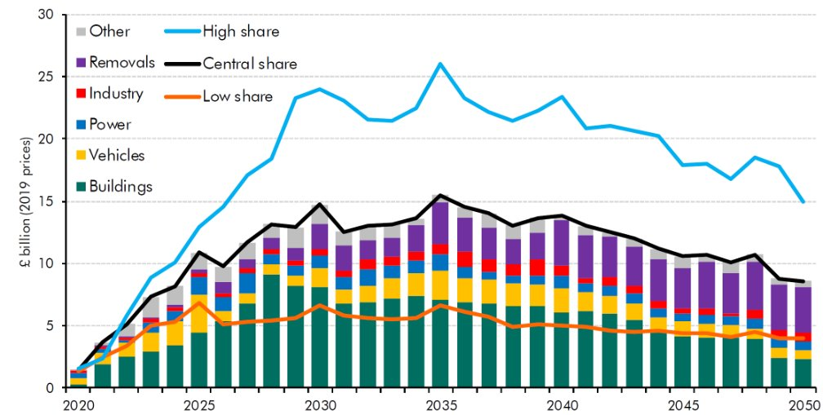
Case Study: UK Energy Transition
The net zero transition will lead to: ​
  Increasing public sector spending.​
  Reductions in public sector tax income.​
Hence there will be a significant impact on public debt during the transition.​
Debt to GDP ratios already high due to fallout from 2007-08 financial crisis and 2020-21 pandemic. ​
Debt sustainability issues more pressing now due to higher levels of inflation and interest rates.
Increase in Government Spending During Transition​
Source: UK OBR (2021)
From: Jackson (2024).

Slide 29
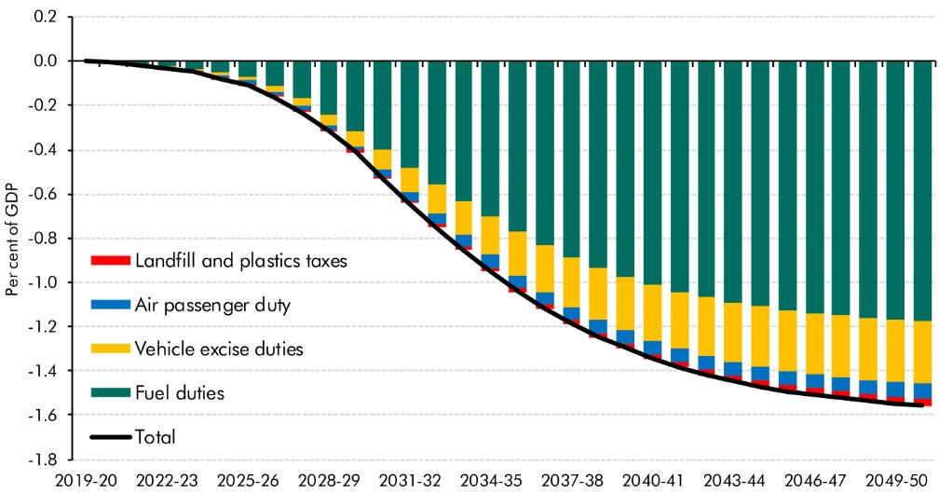
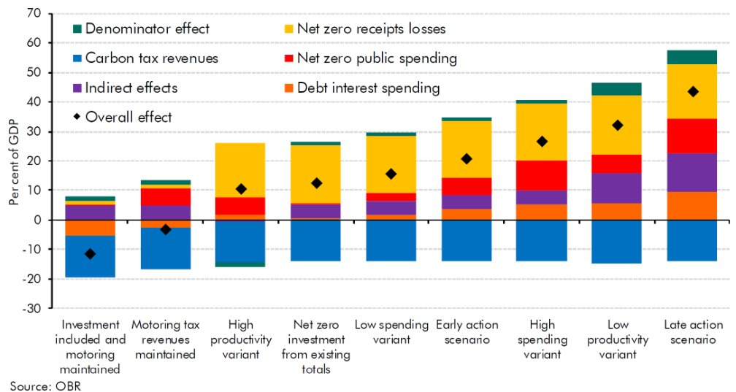
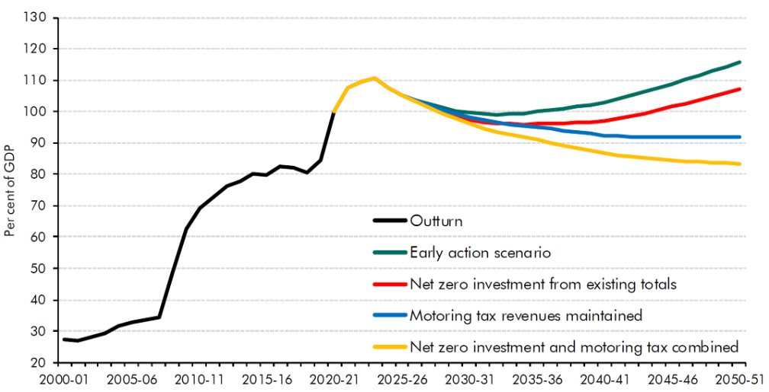
Case Study: UK Energy Transition
Reduction in Tax Income from Motoring, Aviation and Waste Revenues During Transition​ (top) & Impact of Transition on Public Debt-to-GDP Ratio (bottom)
Contributions to Public Sector Debt Scenario Differences From Baseline
From: Jackson (2024).
Source: UK OBR (2021)

Slide 30
Assessing Risk

Slide 31
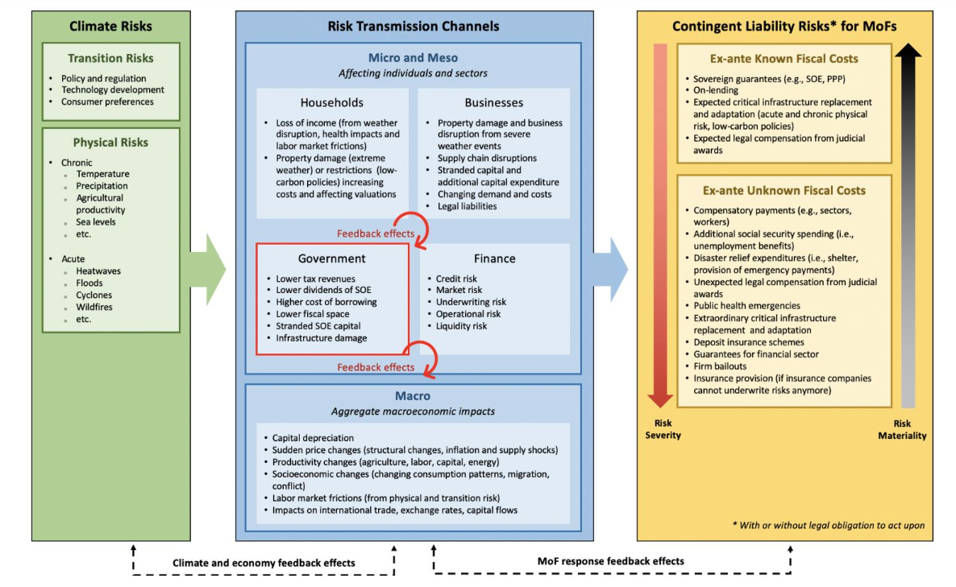
Risks to MoF Assessment

Slide 32
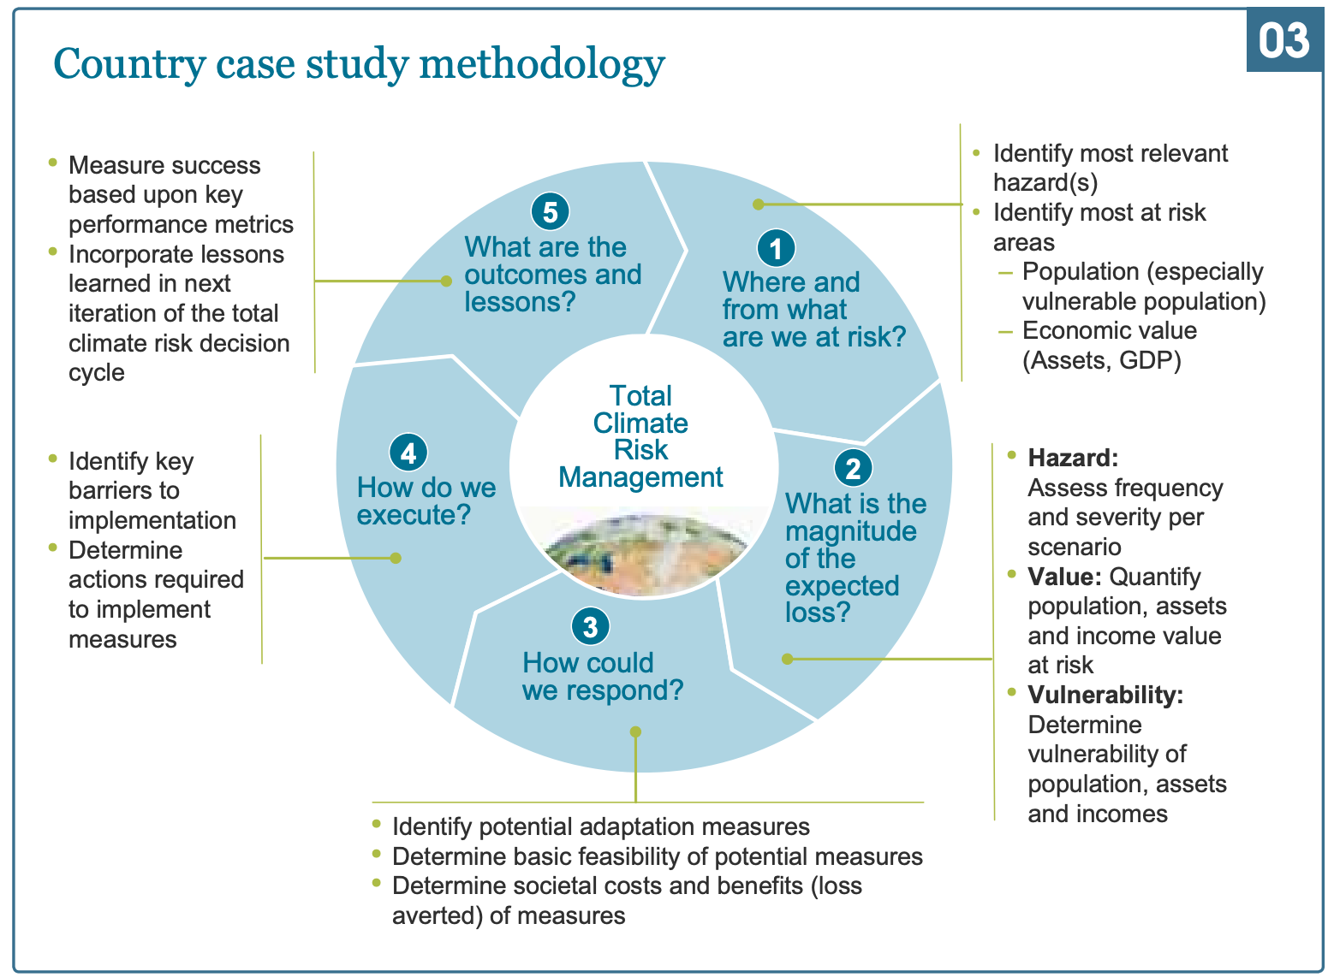
Approach to Assessing Total Climate Risk

Slide 33
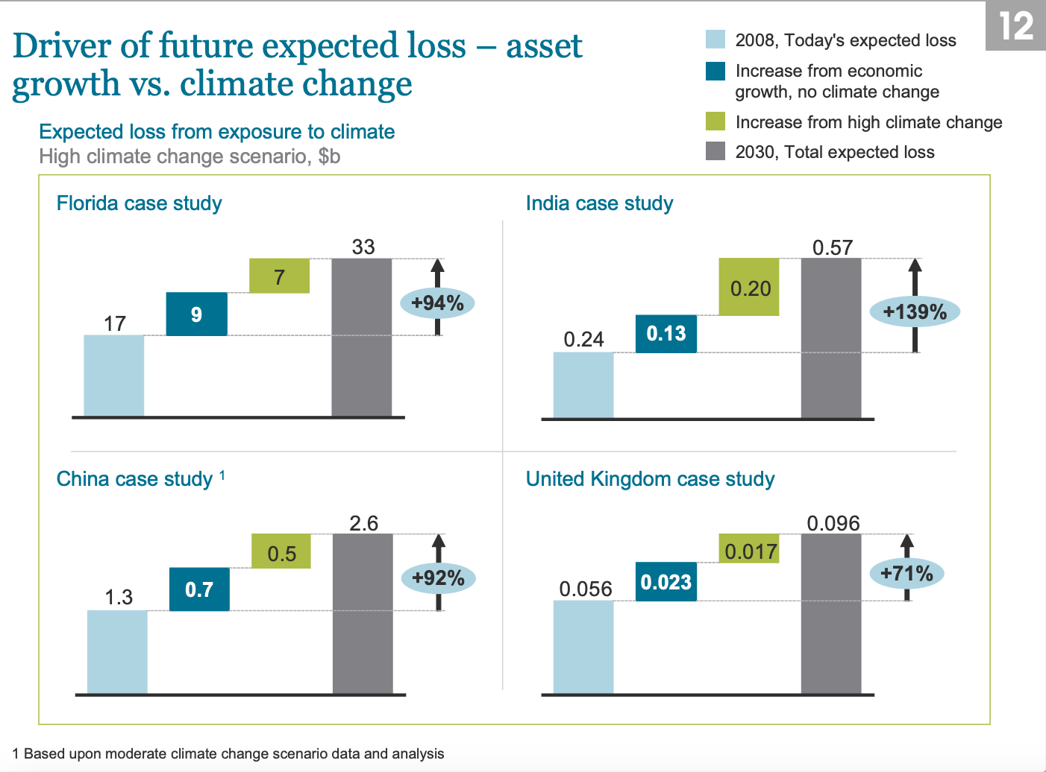
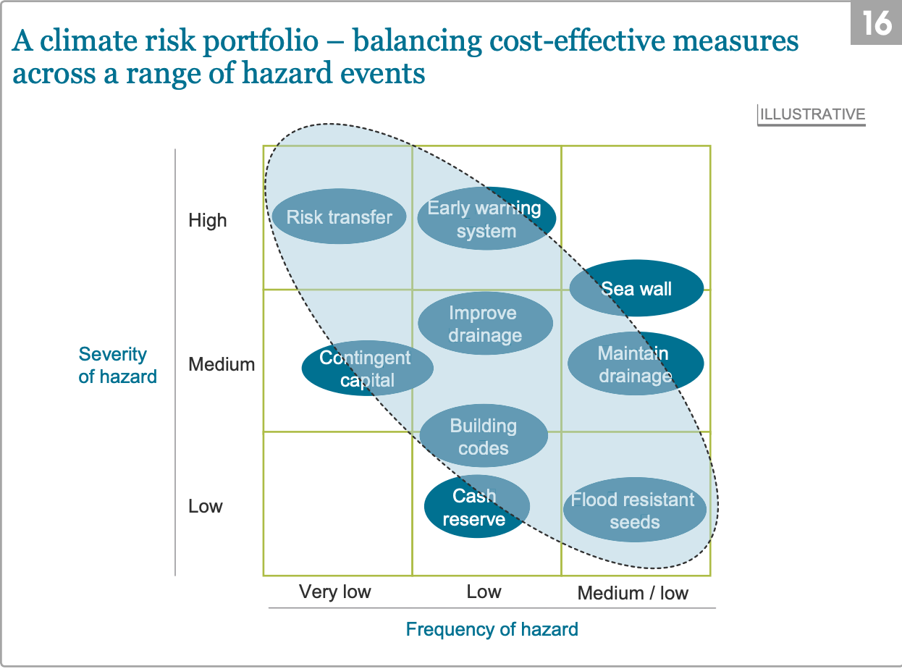
Methodology

Slide 34
Fiscal Institutions: Managing Risks

Slide 35
Key Roles
Revenue Mobilization: Generate funds for, and channel revenues to, climate mitigation and adaptation. E.g., World Bank Sustainable Development Bonds.
Monitoring and Reporting: Track climate-related public spending and assess its effectiveness. E.g., IMF Climate Change Indicators Dashboard.
Coordination and Integration: Align fiscal policies with international climate commitments and coordinate between national and subnational governments. E.g., UNFCCC.

Slide 36
Challenges and Opportunities
Ensuring Equity:
  Addressing the social and economic impacts of climate policies, particularly on vulnerable populations.
  Designing fiscal policies that are both environmentally effective and socially equitable.
Innovation in Financing:
  Exploring new financial instruments (e.g., KPI bonds, climate funds) to attract private sector investment.
  Promoting public-private partnerships for large-scale climate projects.

Slide 37
Thank you!
End of Module D

